Slide 1


Noida Institute of Engineering and Technology, Greater Noida
ARM ARCHITECTURE FOR IoT
UNIT-I
EMBEDDED CONCEPTS
Dr. Zatin Gupta
Associate Professor
B. Tech Fifth Semester
(Internet On Things)

Slide 2
Agenda
Program Outcomes
Course Outcomes
CO-PO Mapping
Syllabus
Course Objective
Objective of Topics
Prerequisite
Content

Slide 3
Faculty Profile
Dr. Zatin Gupta is working as an Associate Professor in the Department of Computer Science & Engineering (IoT) at NIET, Greater Noida, Uttar Pradesh.
Dr. Gupta has completed PhD and M. Tech. in Computer Science Engineering from the Department of Computer Science & Engineering at M. M. Engineering College, Maharishi Markandeshwar (Deemed to be University), Mullana, Ambala, Haryana and earned B. Tech. in Information Technology from Kurukshetra University in 2008.
Since 2008, Dr. Gupta has been active in teaching, Research & Development. He has published several SCI & Scopus indexed Papers. Over 60 of his research papers have been published in refereed international journals and national/ international conferences. He has won 3 National Awards from IIT Roorkee for his research & Development work in the domain of IoT & Embedded Technology.
Dr. Gupta currently holds several National & International patents and copyrights. Several topics, including Internet of Things, Wireless Sensor Networks, Energy Conservation, Smart Farming are currently of interest to him in the realm of research.

Slide 4
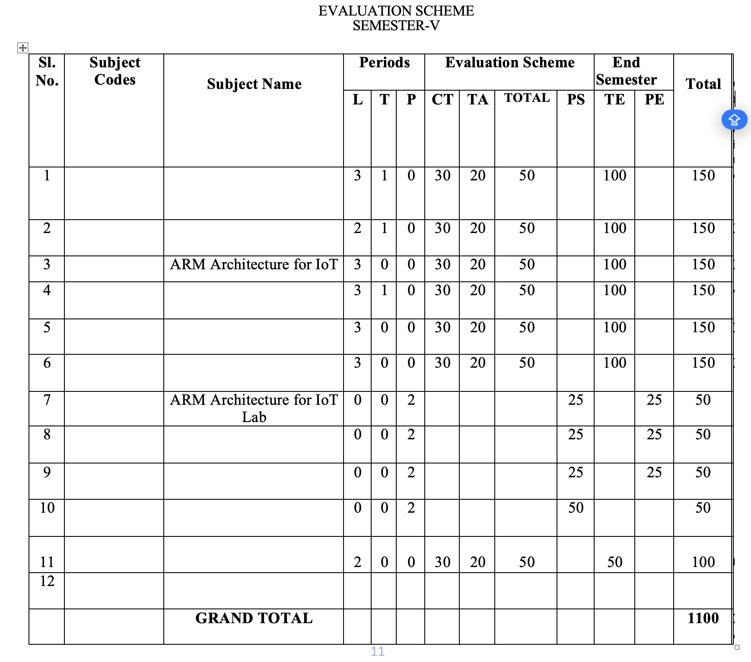
EVALUATION SCHEME

Slide 5
Program Outcomes
1. Engineering knowledge: Apply the knowledge of mathematics, science, engineering fundamentals, and an engineering specialization for the solution of complex engineering problems.
2. Problem analysis: Identify, formulate, research literature, and analyse complex engineering problems reaching substantiated conclusions using first principles of mathematics, natural sciences, and engineering sciences.
3. Design/development of solutions: Design solutions for complex engineering problems and design system components or processes that meet the specified needs with appropriate consideration for public health and safety, and cultural, societal, and environmental considerations.
4. Conduct investigations of complex problems: Use research-based knowledge and research methods including design of experiments, analysis and interpretation of data, and synthesis of information to provide valid conclusions.
5. Modern tool usage: Create, select, and apply appropriate techniques, resources, and modern engineering and IT tools, including prediction and modeling to complex engineering activities, with an understanding of the limitations.
6. The engineer and society: Apply reasoning informed by the contextual knowledge to assess societal, health, safety, legal and cultural issues and the consequent responsibilities relevant to the professional engineering practice.
7. Environment and sustainability: Understand the impact of the professional engineering solutions in societal and environmental contexts, and demonstrate the knowledge of, and need for sustainable development.
8. Ethics: Apply ethical principles and commit to professional ethics and responsibilities and norms of the engineering practice.
9. Individual and team work: Function effectively as an individual, and as a member or leader in diverse teams, and in multidisciplinary settings.
10. Communication: Communicate effectively on complex engineering activities with the engineering community and with the society at large, such as, being able to comprehend and write effective reports and design documentation, make effective presentations, and give and receive clear instructions.
11. Project management and finance: Demonstrate knowledge and understanding of the engineering and management principles and apply these to one’s own work, as a member and leader in a team, to manage projects and in multidisciplinary environments.
12. Life-long learning: Recognize the need for, and have the preparation and ability to engage in independent and life-long learning in the broadest context of technological change.

Slide 6
Course Outcome
Course outcome: After completion of this course students will be able to
CO 1 | Describe ARM processor architectures. | K₁, K₂
CO 2 | Recognize ARM-based microcontrollers as modern IoT computing platforms. | K₁, K_{3,}
CO 3 | Realize Software design basics, software engineering principles. | K_{3,} K₄
CO4 | Explore Target Board FRDM-KL25Z for embedded system application. | K_{3,} K₄
CO 5 | Design smart IoT enabled devices using ARM. | K₂, K_{4,} K₅

Slide 7
ARM ARCHITECTURE FOR IoT |  |  |  |  |  |  |  |  | Year of Study: 2023-24
CO | PO1 | PO2 | PO3 | PO4 | PO5 | PO6 | PO7 | PO8 | PO9 | PO10 | PO11 | PO12
CO1 | 3 | 1 |  | 1 | 0 | 1 | 0 | 0 | 0 | 0 | 0 | 2
CO2 | 3 | 2 | 1 | 2 | 1 | 0 | 1 | 0 | 0 | 0 | 0 | 1
CO3 | 3 | 3 | 3 | 2 | 3 | 1 | 1 | 0 | 0 | 0 | 0 | 2
CO4 | 3 | 2 | 3 | 2 | 3 | 1 | 1 | 0 | 0 | 0 | 0 | 2
CO5 | 3 | 3 | 3 | 3 | 3 | 1 | 1 | 0 | 0 | 0 | 0 | 2
Average | 3 | 2.2 | 2.5 | 2 | 2 | 0.8 | 0.8 | 0 | 0 | 0 | 0 | 1.8

Slide 8
Syllabus
UNIT-I | EMBEDDED CONCEPTS | 8 Hours
Introduction to Embedded Systems, Benefits of Embedded Computer Systems, Microcontroller vs. Microprocessor, MCU Hardware & Software for Concurrency, Difference between Embedded systems OS, IoT device OS, Mobile OS and Desktop OS. RISC and CISC processor Von-Neuman and Harvard Architecture

Slide 9
Course Objectives
After completion of this unit, student should be able to:
Learn the concept Embedded Systems.
Have the knowledge of Microcontroller and microprocessor OS.
Learn the ARM processor architecture.
Explore the knowledge of ARM Processor Families

Slide 10

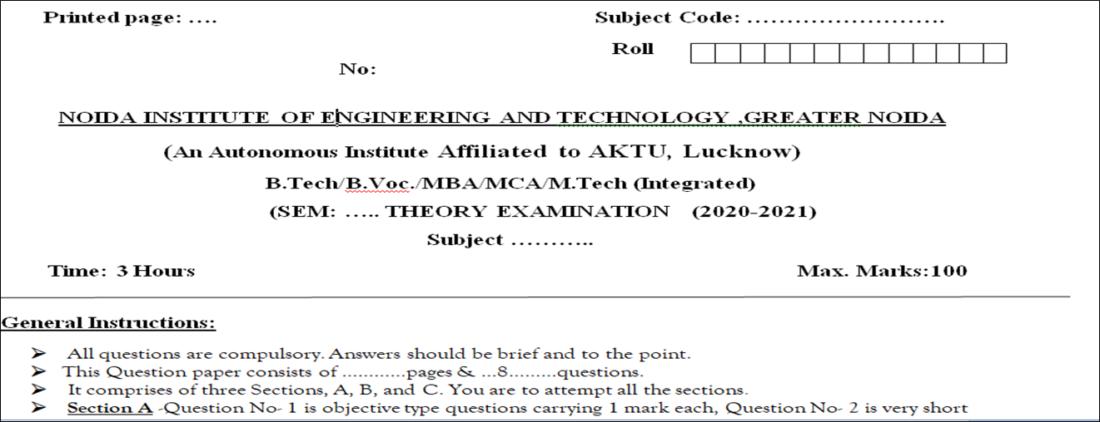
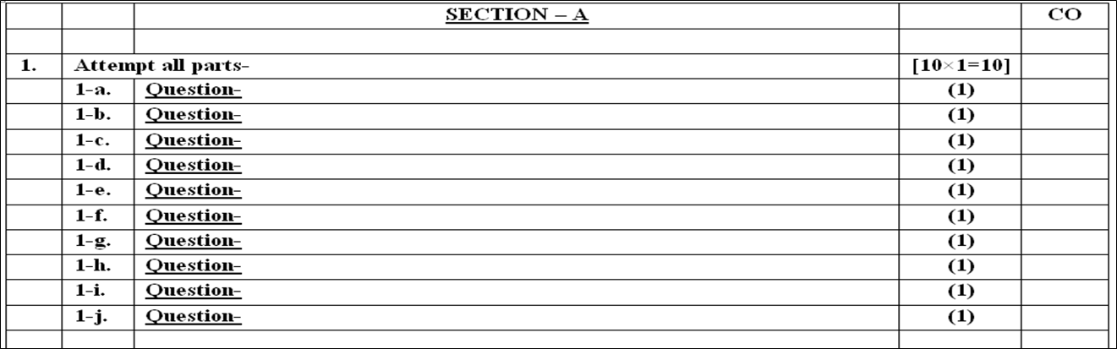
End Semester Question Paper Templates
Evaluation Scheme

Slide 11
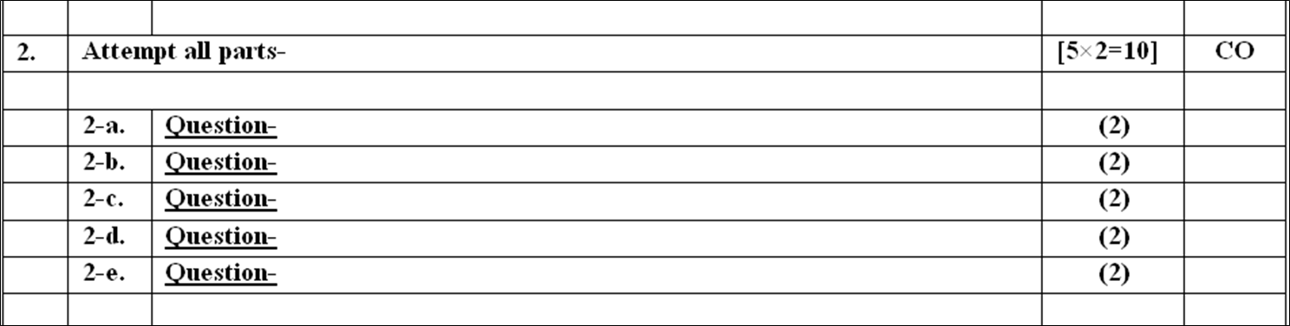
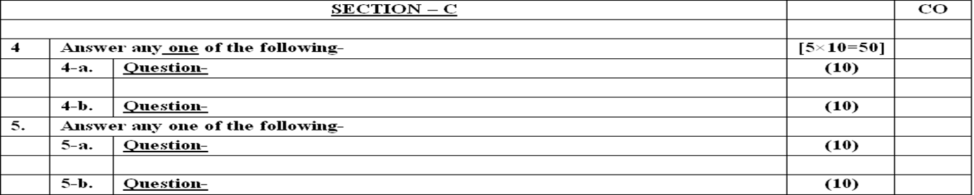
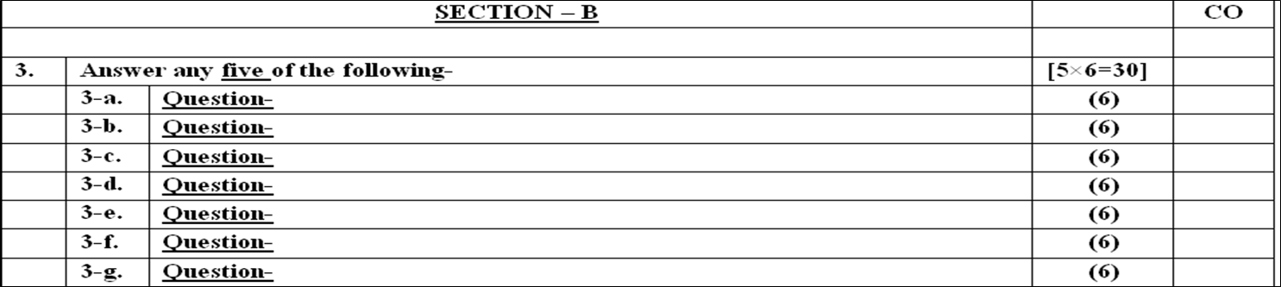
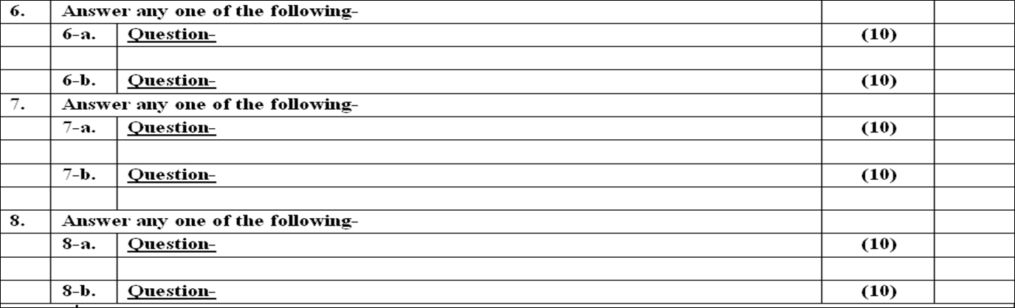
End Semester Question Paper Templates
Evaluation Scheme

Slide 12
Prerequisite and Recap
History of MICROPROCESSOR
Basic of programming
Fundamental of Hardware

Slide 13
Basic Introduction
What is embedded?
Embedded refers to the integration of a computer system within a larger device or product to perform specific functions. These embedded systems are typically designed to operate autonomously with specific capabilities, such as controlling machinery, monitoring processes, or managing communication protocols.
How does embedded technology work?
Embedded technology works by incorporating specialized hardware and software into a device, enabling it to perform dedicated functions. The embedded system processes data from sensors or user input and executes predefined tasks, making it efficient and reliable for its intended purpose.
What are the advantages of using embedded systems?
Embedded systems offer several advantages, such as increased reliability due to their dedicated function, lower power consumption, compact size, and the ability to perform real-time operations, making them suitable for time-sensitive applications.
How do embedded systems differ from general-purpose computers?
Embedded systems are designed for specific tasks and are typically not user-programmable, unlike general-purpose computers. They focus on efficiency and reliability, while general-purpose computers are more versatile and allow users to run various applications.
What programming languages are commonly used in embedded systems?
C and C++ are widely used in embedded systems due to their efficiency, low-level access to hardware, and portability. Other languages like Python and Java are also gaining popularity as they provide higher-level abstractions and ease of development.

Slide 14
Microprocessor & Microcontroller
Microcontroller
Microprocessor
Peripherals IC’s
DMA/PPI/timer/counter/Interrupt Controller/USART etc.
ALU
CU
Registers
EEPROM
Main Memory/ RAM
Secondary Memory/HD

Slide 15
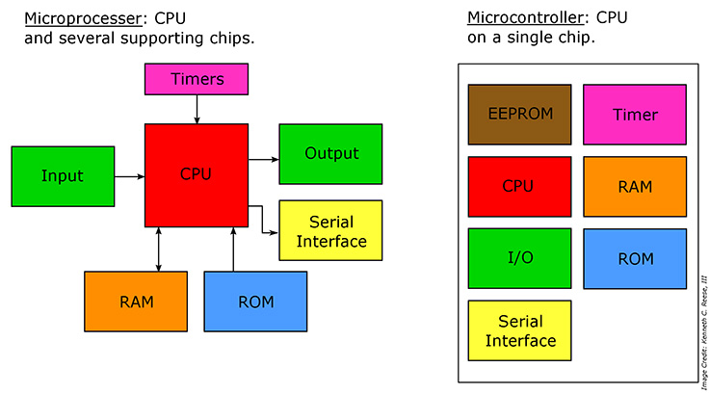
Microcontroller v/s Microprocessor

Slide 16
Microprocessor v/s Microcontroller
Microprocessor: A microprocessor is a computer processor where the data processing logic and control is included on a single integrated circuit, or a small number of integrated circuits. The microprocessor contains the arithmetic, logic, and control circuitry required to perform the functions of a computer's central processing unit.
Microcontroller: A microcontroller is a compact integrated circuit designed to govern a specific operation in an embedded system. A typical microcontroller includes a processor, memory and input/output (I/O) peripherals on a single chip. Sometimes referred to as an embedded controller or microcontroller unit (MCU).

Slide 17
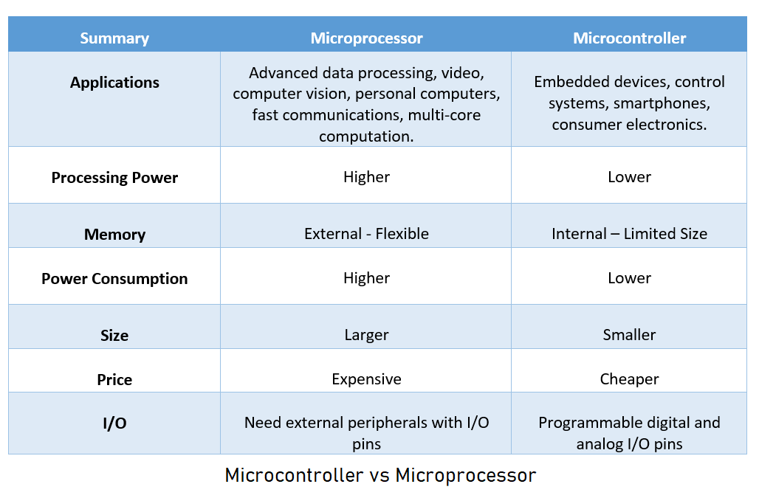

Slide 18
Systems
One can also use HDL to design it, or full custom designing
Non Electronics Systems
Electronics Systems
Analog Systems
A/D
or
D/A
Digital Systems
System design with hardware approach (ASIC),
Digital Watch, seven segment etc.
Systems design with hardware cum software approach
Embedded System using Microcontroller or Microprocessor
General purpose Systems using Microprocessor, Laptop, PC

Slide 19
General Purpose system
General purpose systems, are is same as BIG BAZAR
Microprocessor is as the owner, has to be very much skilled
peripheral IC’s are it’s employee
Customers are the applications
Area of it is memory
Owner No idea what peoples will buy
He will put all type of stuff and appoint employee in his store to satisfy his customers
BIG BAZAR
A
General Store
Peoples
Needs to buy many stuff
Entry/exit
(need huge area, lot’s of employee, every kind of stuff, great investment)

Slide 20
General purpose System: Computer system
A general-purpose system is a computer system that can be programmed to perform a large number of tasks.
General-purpose computers are designed so that users or devices can interact with them in a variety of ways to meet a broad range of needs.
The ability to run many different pieces of software allows a general-purpose system to be quite versatile in terms of the types of tasks it can perform. Software can be added, updated, and removed fairly easily, which alters the functionality of a system.
As general-purpose systems are designed to carry out many different types of process, they are often not fully optimized to perform each individual task.

Slide 21
Embedded System
Small scale Embedded systems are same as a watch shop
Microcontroller like owner, not necessary to be very skilled
Specific customer who need watch are like specific application
Small area of shop means less memory needed
Owner know what peoples will buy
watch -shop
He will put all type watches customers
Peoples
Needs to buy watches
Entry/exit
(need less area, watches, small investment)

Slide 22
Embedded Systems
Any Microcontroller or Microprocessor based System which is exclusive for specific application is known as Embedded System.
Or
It can be said that the combination of hardware and software which perform specific task are embedded systems.
Embedded systems are computer systems that carry out a small number of tasks. When designing an embedded system, manufacturers will focus on the dedicated functions that the system needs to perform. They will optimize the system until it performs each of these tasks very efficiently.
Example: EVM, ATM machine, Vending Machine, Video-game, I-pod, Rockets, Sidelights etc.

Slide 23
Embedded system can classify in three categories
Small Scale Embedded System (Microcontroller based)
Medium Scale Embedded system (Microcontroller + RTOS)
Sophisticated Scale Embedded system(multiple Microprocessor + RTOS)

Slide 24
Small Scale Embedded System
Small Scale Embedded Systems are designed using an 8-bit or 16-bit micro-controller.
They can be powered by a battery. The processor uses very less/limited resources of memory and processing speed.
Mainly these systems does not act as an independent system they act as any component of computer system but they did not compute and dedicated for a specific task.
Example: EVM, Toy-Car, Calculator etc.

Slide 25
Medium Scale Embedded system
Medium Scale Embedded Systems are designed using an 16-bit or 32-bit micro-controller.
These medium Scale Embedded Systems are faster than that of small Scale Embedded Systems.
Integration of hardware and software is complex in these systems.
Java, C, C++ are the programming languages are used to develop medium scale embedded systems.
Different type of software tools like compiler, debugger, simulator etc. are used to develop these type of systems.
Example: Coffee vending machine, Token Display System etc..

Slide 26
Sophisticated Embedded system
Sophisticated or Complex Embedded Systems are designed using multiple 32-bit or 64-bit micro-controller. These systems are developed to perform large scale complex functions.
These systems have high hardware and software complexities. We use both hardware and software components to design final systems or hardware products.
A large scale embedded system requires one or more microprocessor along with memory having fixed applications and RTOS to manage all pre decided applications.
Example: Rocket, Satellite, Network Servers etc.

Slide 27
Operating System
An operating system (OS) is the program that, after being initially loaded into the computer by a boot program, manages all of the other application programs in a computer.
The application programs make use of the operating system by making requests for services through a defined application program interface (API).
In addition, users can interact directly with the operating system through a user interface, such as a command-line interface (CLI) or a graphical UI (GUI).

Slide 28
Why use an operating system: Applications
An operating system brings powerful benefits to computer software and software development.
Without an operating system, every application would need to include its own UI, as well as the comprehensive code needed to handle all low-level functionality of the underlying computer, such as disk storage, network interfaces and so on.
Considering the vast array of underlying hardware available, this would vastly bloat the size of every application and make software development impractical.

Slide 29
Why use an operating system: Applications
Instead, many common tasks, such as sending a network packet or displaying text on a standard output device, such as a display, can be offloaded to system software that serves as an intermediary between the applications and the hardware.
The system software(OS) provides a consistent and repeatable way for applications to interact with the hardware without the applications needing to know any details about the hardware.

Slide 30
Why use an operating system: Applications
As long as each application accesses the same resources and services in the same way, that operating system can service almost any number of applications.
This vastly reduces the amount of time and coding required to develop and debug an application, while ensuring that users can control, configure and manage the system hardware through a common and well-understood interface.

Slide 31
General OS/ Desktop OS
The desktop OS is the environment where the user controls a personal computer (Desktop, Notebook PC). It aids in the management of computer hardware and software resources. It supports fundamental features such as task scheduling, peripheral control, printing, input/output, and memory allocation. The operating system serves as a bridge between programs and computer hardware.
General OS used in General purpose systems.
Like in Laptop and Desktop systems.
Example: Window-10, Window-11, Linux etc…
When multiple different sizes applications needed to be process we use General OS.

Slide 32
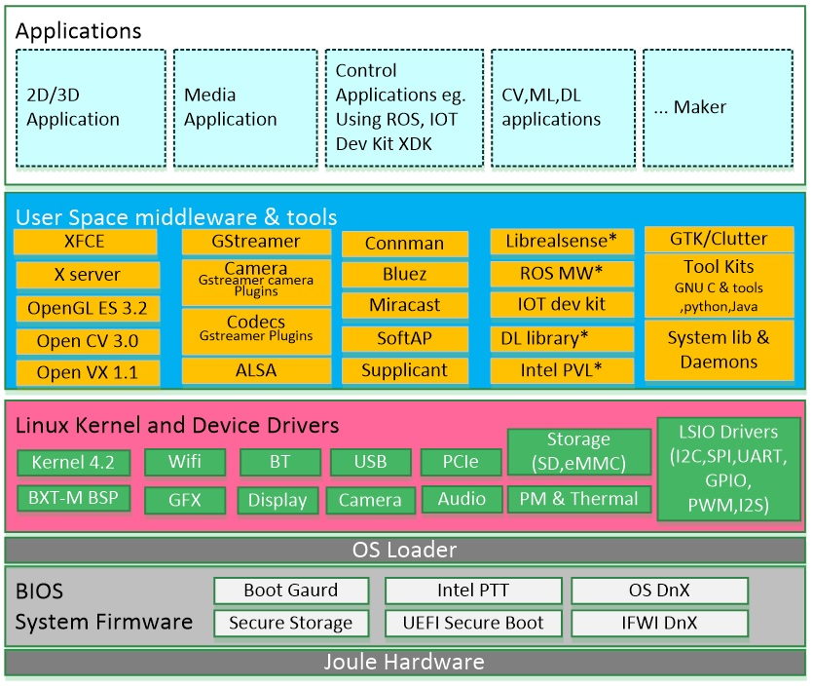
Desktop OS/ General OS

Slide 33
RTOS
Real Time Operating Systems used in Embedded system also called Embedded OS, Used in Medium or Sophisticated Embedded systems.
Like used in ATM machine, ACVM (Automatic chocolate vending Machine)
Example: VxWorks, Symbian, RT-Linux etc..

Slide 34
Embedded OS/RTOS
An embedded operating system is a specialized customized operating system (OS) designed to perform a specific task for a device that is not a computer. The main job of an embedded OS is to run the code that allows the device to do its job. The embedded OS also makes the device's hardware accessible to software that is running on top of the OS.
Real Time Operating Systems used in Embedded system also called Embedded OS, Used in Medium or Sophisticated Embedded systems.
Like used in ATM machine, ACVM (Automatic chocolate vending Machine)
Example: VxWorks, RT-Linux etc..

Slide 35

RTOS/Embedded OS/Customized OS
For My customised need I will not use all general OS components , I will select only required components of OS
I just want to Make an Embedded system Like ATM machine
Microcontroller or Microcomputer or Microprocessor selection as per the requirement.
Memory As Needed for the application program and Data
Customised OS
OS Operations
Peripherals Controller as needed

Slide 36
Small OS
Small OS can be categorized as
IoT device OS
Mobile OS.
IoT Device OS like Raspbian used in Raspberry-pi minicomputer.
Mobile OS like Android used in mobile phones.

Slide 37
IoT Device OS
A IoT operating system like raspberry-pi OS, is an light version of General operating system developed on Linux.
IoT operating systems found on minicomputer like raspberry-pi and beaglebone.
It has all the features of General OS and have capability of multiprogramming.
It combines the beauty of computer in IoT devices. It typically contains a USB, Audio, memory, display and many protocol controller and internet connections.

Slide 38
Mobile OS
A mobile operating system is an operating system that helps to run other application software on mobile devices. It is the same kind of software as the famous computer operating systems like Linux and Windows, but now they are light and simple to some extent.
The operating systems found on smartphones include Symbian OS, iPhone OS, RIM's BlackBerry, Windows Mobile, Palm WebOS, Android, and Maemo. Android, WebOS, and Maemo are all derived from Linux. The iPhone OS originated from BSD and NeXTSTEP, which are related to Unix.
It combines the beauty of computer and hand use devices. It typically contains a cellular built-in modem and SIM tray for telephony and internet connections. If you buy a mobile, the manufacturer company chooses the OS for that specific device.

Slide 39


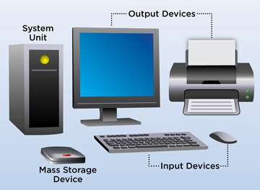
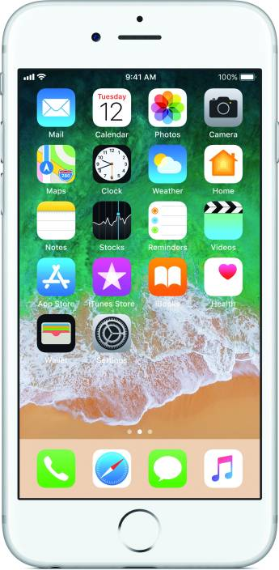
X
X
X
Android Operating system
To Understand Android lets go back to and understand Computer Operating Systems like Windows and Linux
X
What is Android??
X
X
X
X
X
General Purpose System
X
X
Huge Memory
User want to play big games, MS office, pdf reader, multiple multimedia players , internet, cloud, learning software, satellite control, missile Guidance, Networking Server and many more
Limited Small Apps
Operating System schedule all
I just want to connect peoples, some small games and internet access
Small
User want to play big games, MS office, pdf reader, multiple multimedia players , internet, cloud, learning software, satellite control, missile Guidance, Networking Server and many more
High Capacity Processor
Low

Slide 40
RISC and CISC
Reduced Instruction Set Computer (RISC) – The main idea behind this is to make hardware simpler by using an instruction set composed of a few basic steps for loading, evaluating, and storing operations just like a load command will load data, a store command will store the data.
Complex Instruction Set Computer (CISC) – The main idea is that a single instruction will do all loading, evaluating, and storing operations just like a multiplication command will do stuff like loading data, evaluating, and storing it, hence it’s complex.

Slide 41
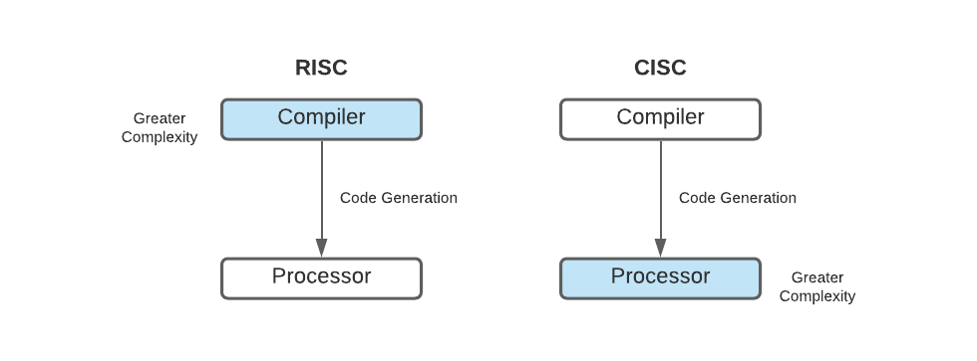
RISC and CISC
Both approaches try to increase the CPU performance
RISC: Reduce the cycles per instruction at the cost of the number of instructions per program.
CISC: The CISC approach attempts to minimize the number of instructions per program but at the cost of an increase in the number of cycles per instruction.

Slide 42
Characteristic of RISC
Simpler instruction, hence simple instruction decoding.
Instruction comes undersize of one word.
Instruction takes a single clock cycle to get executed.
More general-purpose registers.
Simple Addressing Modes.
Fewer Data types.
A pipeline can be achieved.

Slide 43
RISC vs CISC
RISC | CISC
Focus on software | Focus on hardware
Uses only Hardwired control unit | Uses both hardwired and microprogrammed control unit
Fixed sized instructions | Variable sized instructions
Requires more number of registers | Requires less number of registers
Code size is large | Code size is small
An instruction executed in a single clock cycle | Instruction takes more than one clock cycle
An instruction fit in one word | Instructions are larger than the size of one word

Slide 44
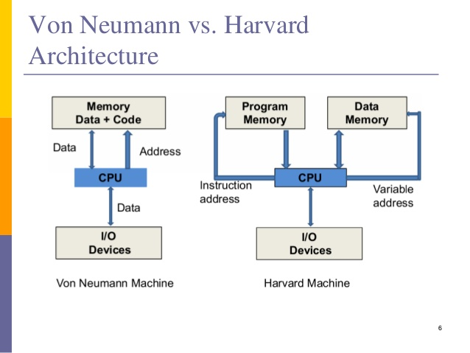

Slide 45
VON NEUMANN ARCHITECTURE vs HARVARD ARCHITECTURE
VON NEUMANN ARCHITECTURE | HARVARD ARCHITECTURE
Von-Neumann architecture is an ancient computer architecture based on the stored-program computer concept. | Harvard architecture is a modern computer architecture based on the “Harvard Mark I” relay-based model.
The same physical memory address is used for instructions and data. | A separate physical memory address is used for instructions and data.
A common bus is used for data and instruction transfer. | Separate buses are used for transferring data and instruction.
The processing unit would require two clock cycles to complete an instruction. | The processing unit can complete instruction in one cycle if appropriate pipelining plans have been set.
It is cheaper in cost. | It is costly than Von-Neumann architecture.
CPU cannot access instructions and read/write at the same time. | CPU can access instructions and read/write at the same time.
It is used in personal computers and small computers. | It is used in microcontrollers and signal processing.

Slide 46
Sample Questions
What is Embedded C Programming? How is Embedded C different from C language?
What is ISR?
Explain what is embedded system in a computer system?
Difference between RISC and CISC processor?
What are the components of an embedded system?

Slide 47
Sample Questions
What is the difference between Von-Neuman and Harvard Architecture?
What’s the difference between a microcontroller and a microprocessor?
What is the boot-loader?
Differentiate General Systems and Embedded Systems with suitable example.

Slide 48
Sample Questions
What do you mean by a real-time system?
What is RTOS?
What is the kernel?
Can MCU run code directly from flash?
Explain types of Embedded systems.
What are the MCU Hardware & Software’s?
What is ARM?
Which type of OS used in Raspberry-pi minicomputer?

Slide 49
Sample MCQ
1. Which memory storage is widely used in PCs and Embedded Systems? a) EEPROM b) Flash memory c) SRAM d) DRAM
2. How is the protection and security for an embedded system made? a) Security chips b) Memory disk security c) IPR d) OTP
3. Which type of memory is suitable for low volume production of embedded systems? a) Non-volatile b) RAM c) Volatile d) ROM
4. Which level simulates the algorithms that are used within the embedded systems? a) algorithmic level b) switch level c) gate level d) circuit level
5. Which of the following statements are true for von Neumann architecture? a) separate bus between the program memory and data memory b) external bus for program memory and data memory c) external bus for data memory only d) shared bus between the program memory and data memory
6. Which ports are used in the multi-master system to avoid errors? a) bidirectional port b) tri-directional port c) multi directional port d) unidirectional port
7. What allows the data protection in the software interrupt mechanism? a) TRAP b) SWI c) Same mode d) Different mode
8. Which one of the following offers CPUs as integrated memory or peripheral interfaces? a) Memory system b) Embedded system c) Microcontroller d) Microprocessor
9. What is 80/20 rule? a) 80% instruction is generated and 20% instruction is executed b) 80% instruction is executed and 20% instruction is generated c) 80%instruction is executed and 20% instruction is not executed d) 80% instruction is generated and 20% instructions are not generated
10. Which is the first company who defined RISC architecture? a) Intel b) IBM c) Motorola d) MIPS

Slide 50
Thank You

